Slide 1
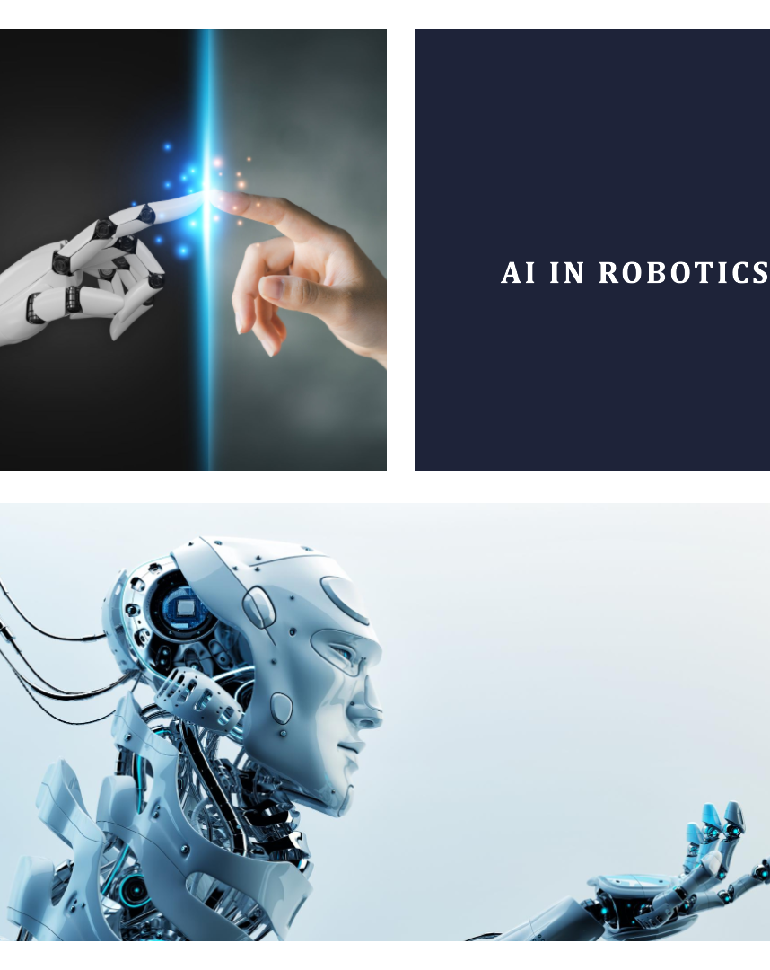
Imagine a world where robots are not just machines that perform repetitive tasks, but intelligent assistants that work alongside us, enhancing our lives in countless ways.

Slide 2
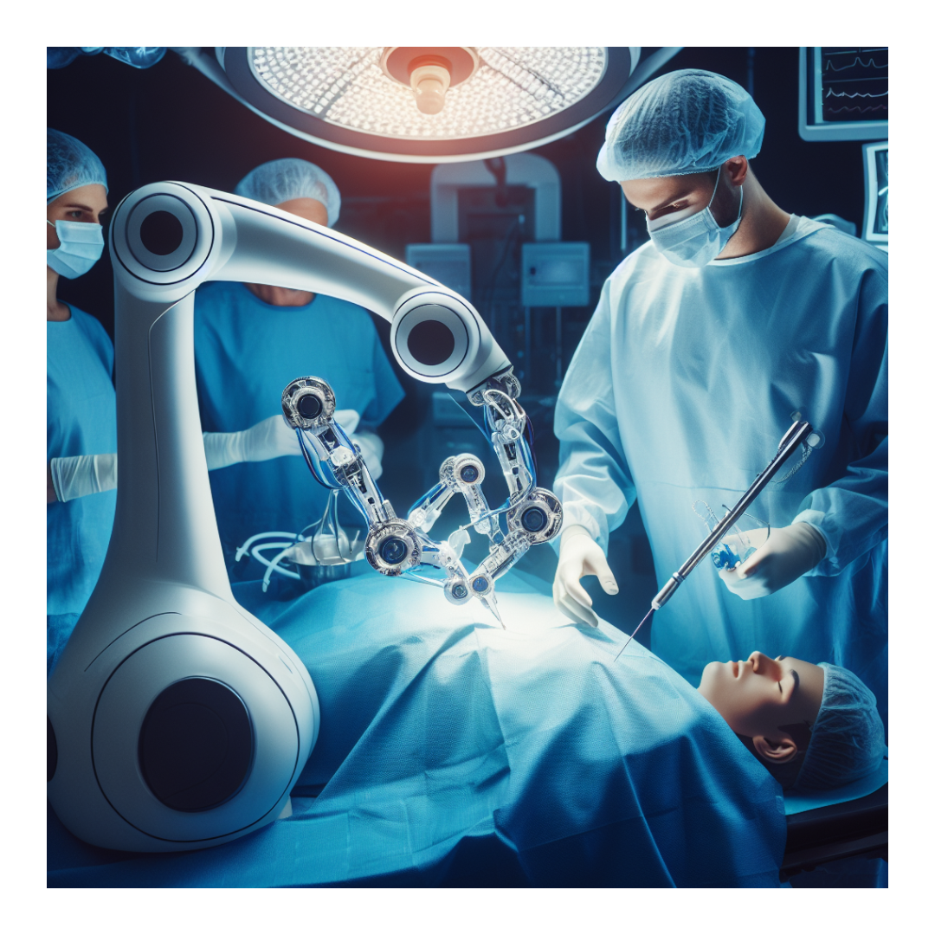

Robot-Assisted Surgery
A Surgeon's Precision with
AI's Guidance
In the field of healthcare, AI-powered robots are transforming surgery, enabling surgeons to perform intricate operations with supreme precision and accuracy. AI algorithms can analyze medical images, provide real-time guidance during surgery, and monitor patient conditions, ensuring optimal outcomes.

Slide 3
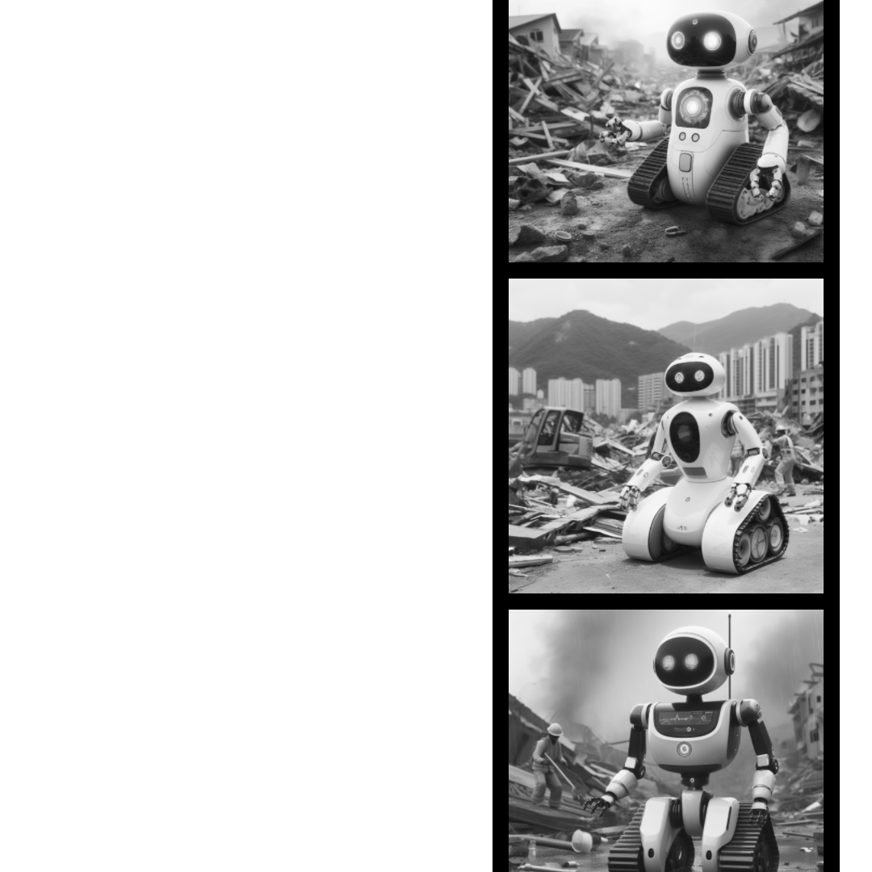

Navigation and Teleoperation
Embracing Complexity with
AI's Intelligence
AI is equipping robots with the ability to navigate complex and dynamic environments, from bustling urban streets to disaster zones and even the vast area of outer space. AI algorithms can process sensor data, identify obstacles, and plan optimal routes, allowing robots to operate autonomously in challenging settings.

Slide 4
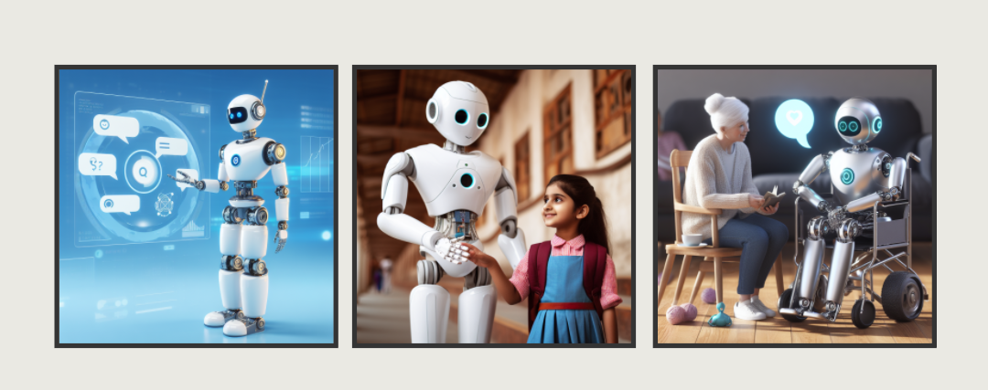
Companionship and Support Powered by AI:
AI is fostering a new generation of socially assistive robots that offer companionship and support to individuals of all ages, particularly the elderly, children, and those facing health challenges. AI enables robots to understand human emotions, preferences, and needs, providing empathetic and personalized support.
Socially Assistive Robots

Slide 5
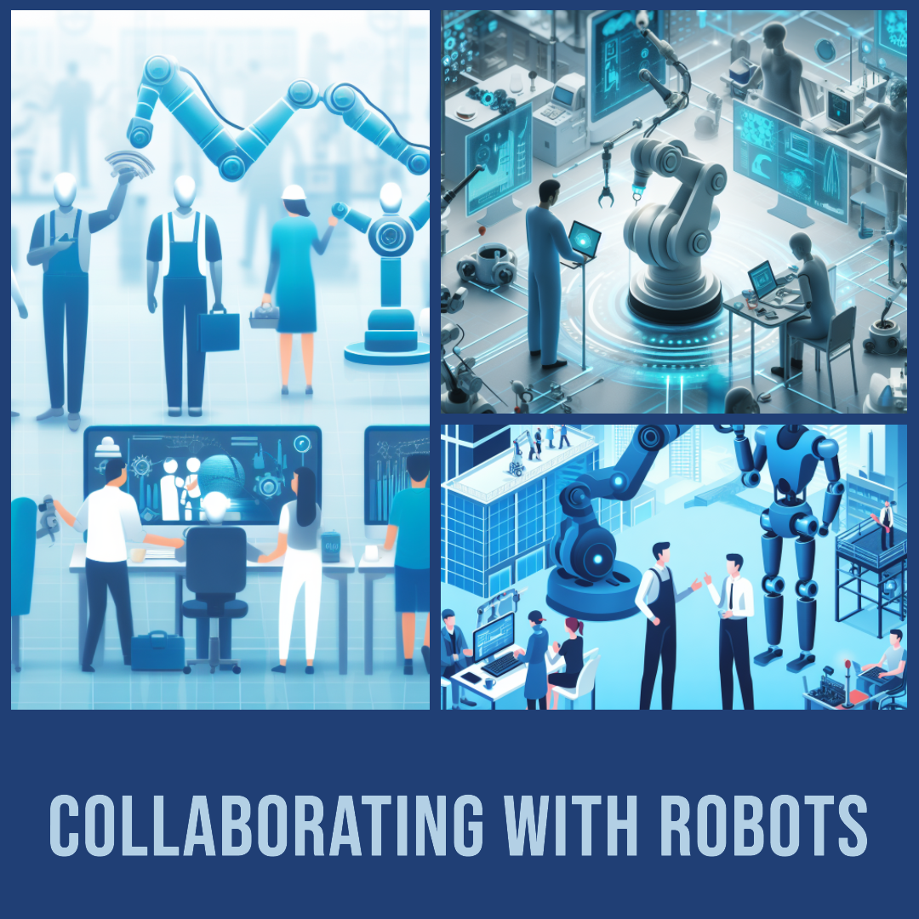
Human-Robot Collaboration
A Seamless Partnership for Enhanced Efficiency
AI is bridging the gap between humans and robots, enabling them to collaborate seamlessly in various settings, from factories and offices to homes and hospitals.
AI algorithms allow robots to recognize human actions, intentions, and gestures, coordinating their behavior accordingly and learning from human feedback to improve performance.

Slide 6
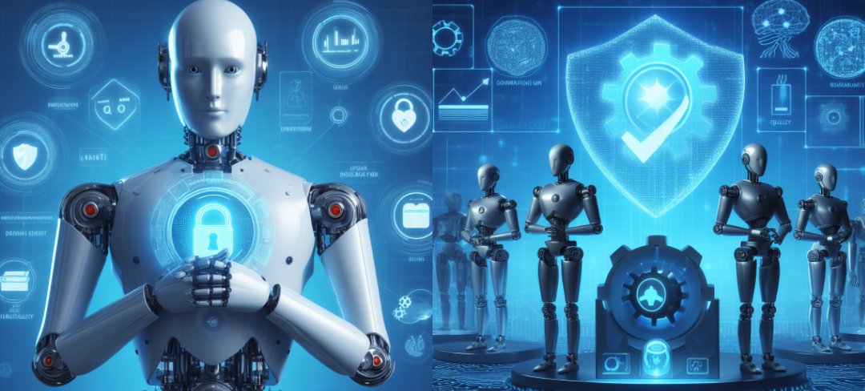
AI is empowering robots to become vigilant guardians of quality, ensuring that products and processes meet the highest standards. AI algorithms can detect defects and anomalies in real-time, prevent production errors, and optimize efficiency, reducing waste and enhancing overall quality.
Quality Assurance in Operations
AI's Vigilant Eye for Excellence

Slide 7
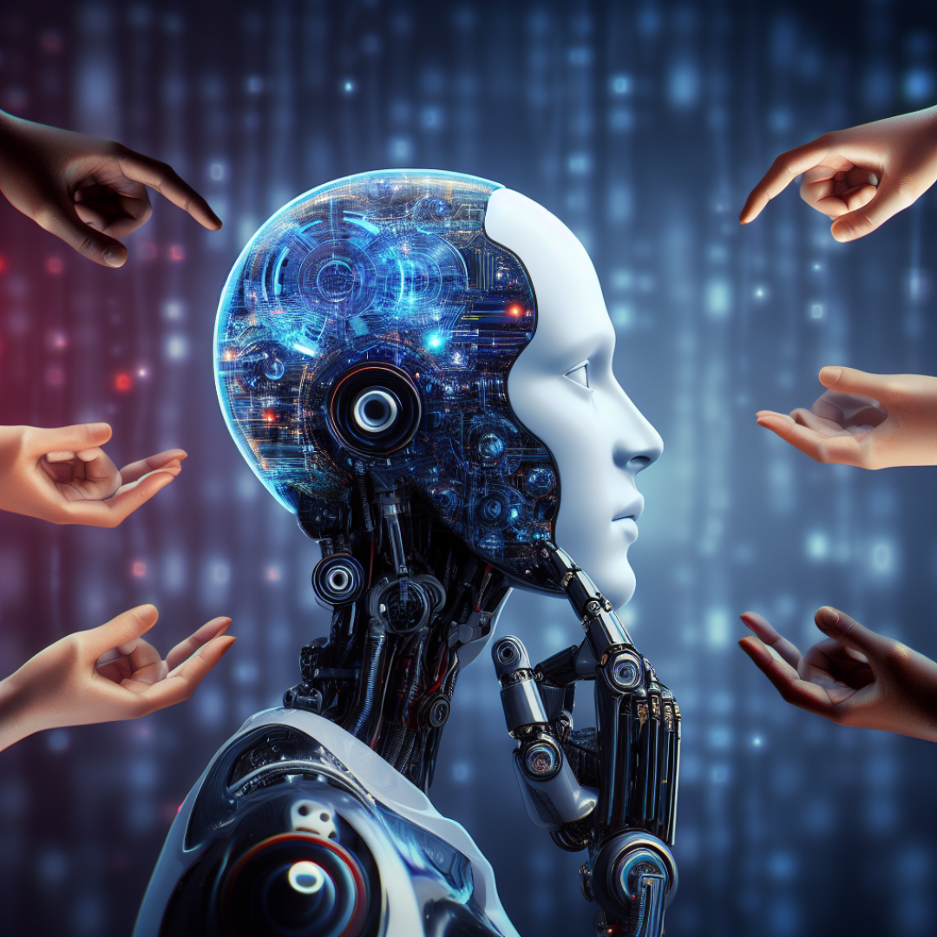
The Challenge of Bias
Navigating AI Responsibly
As with any powerful technology, AI in robotics must be developed and deployed with careful consideration of potential challenges and risks. One of the most pressing concerns is the issue of bias. AI systems can reflect the biases of the data they are trained on, potentially leading to unfair or discriminatory outcomes.

Slide 8
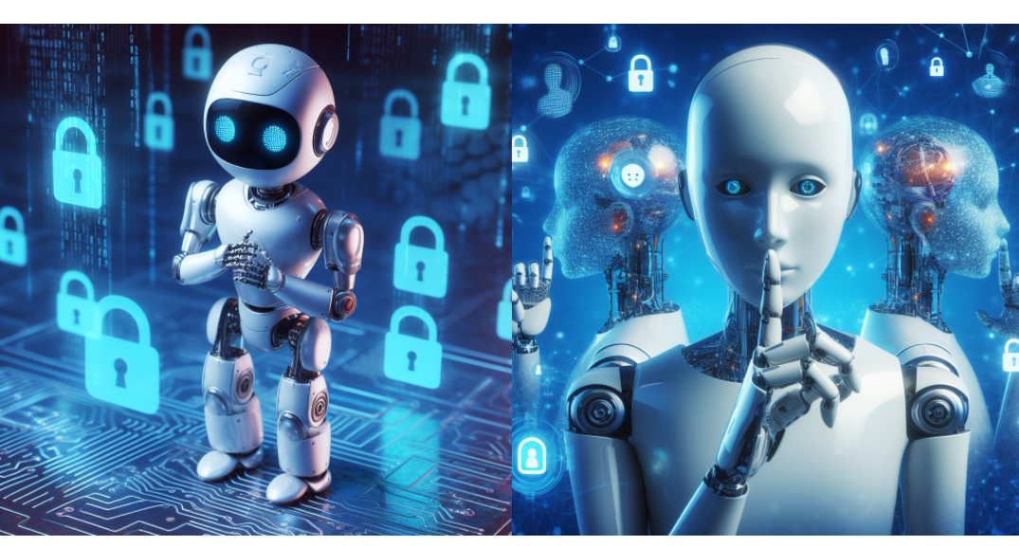
Security and Privacy
Protecting Data and Individual Rights
AI robots collect and process vast amounts of data about people and their environment, raising concerns about privacy and security. It is crucial to implement robust safeguards to protect sensitive data from unauthorized access or misuse.

Slide 9
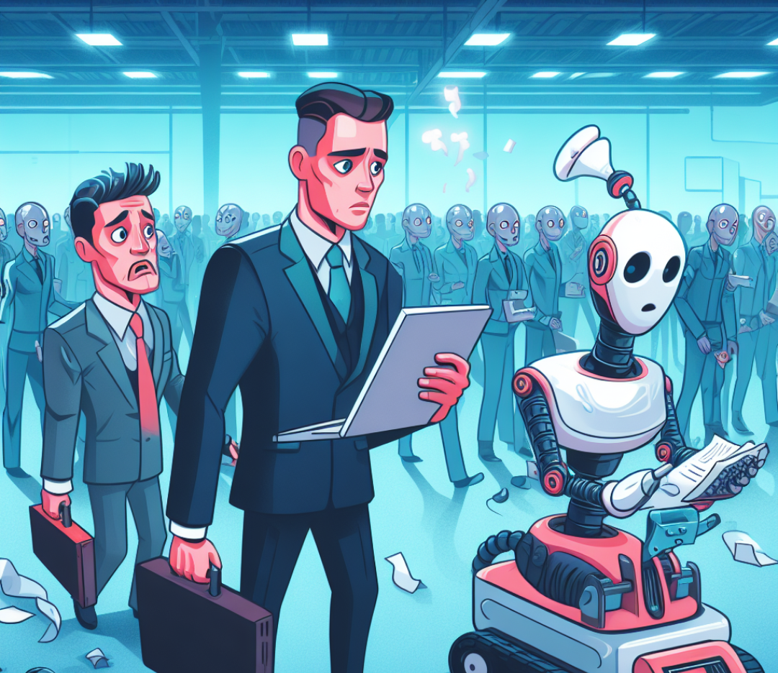

Job Displacement
Navigating the Changing Landscape of Work
As AI robots become more capable, they may replace certain human workers in some industries. This raises concerns about job displacement and its potential social and economic consequences. It is essential to develop strategies to mitigate these impacts, such as reskilling and upskilling initiatives.

